Slide 1


What is one thing from COMP6080 that you want to achieve by the end of this term?
ⓘ
Click Present with Slido or install our Chrome extension to activate this poll while presenting.
Notes:
📣 This is Slido interaction slide, please don't delete it. ✅ Click on 'Present with Slido' and the poll will launch automatically when you get to this slide.

Slide 2
Welcome to Front End!
COMP6080 Week 1
Tutorial: H17A
Tutor: Edison Hien
Credits to Kate Oh for slide template :D

Slide 3
Agenda
01
Introduction
02
Housekeeping
03
Icebreaker
04
Tutorial Exercises
05
Wrap Up + Q&A

Slide 4
Introduction
Hi, I’m Edison!
4th and final year Computer Science student
Software Engineer Intern at Nine
Took COMP6080 in 23T1
You’ll see me in tutorials, forum posts and help sessions
Email me at z5308785@unsw.edu.au if you need me!

Slide 5
Housekeeping
Course Resources
Course Website: https://cgi.cse.unsw.edu.au/~cs6080/23T3
EdStem Forum: https://edstem.org/au/courses/13869/discussion/
GitLab Repos: https://nw-syd-gitlab.cseunsw.tech/COMP6080/23T3/
Course Admin Email: cs6080@cse.unsw.edu.au
Course Updates
Assignment 1 ‘PicToCode’ Released: due Week 3 Friday 29th September, 10pm

Slide 6
Icebreaker
In groups of 3, you will spend 5 minutes collecting 4 links to websites
2 links should be websites that your group thinks are great
The other 2 links should be websites that your group thinks are pretty awful
We’ll then discuss whether these websites are good or bad as a class!

Slide 7
Please enter the links to the websites here!
ⓘ
Click Present with Slido or install our Chrome extension to activate this poll while presenting.
Notes:
📣 This is Slido interaction slide, please don't delete it. ✅ Click on 'Present with Slido' and the poll will launch automatically when you get to this slide.

Slide 8
Lecture Recap
HTML
CSS
JavaScript
Week 1 Content
Coming in Week 2
Page structure
Page aesthetics
Page dynamics

Slide 9
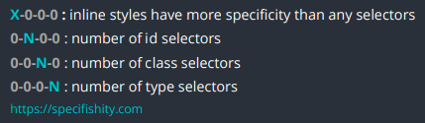
CSS Specificity
Inline styles: <h1 style=”color: red;”>
IDs: <h1 id=”red”>
Classes, Pseudo-classes, Attribute selectors: <h1 class=”red”>
Type selectors and Pseudo-elements: <h1></h1>

Slide 10
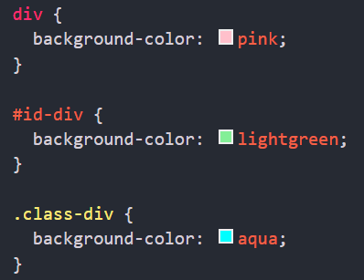

What would be the background colour of this div?

Slide 11

What would be the background colour of this div?
ⓘ
Click Present with Slido or install our Chrome extension to activate this poll while presenting.
Notes:
📣 This is Slido interaction slide, please don't delete it. ✅ Click on 'Present with Slido' and the poll will launch automatically when you get to this slide.

Slide 12
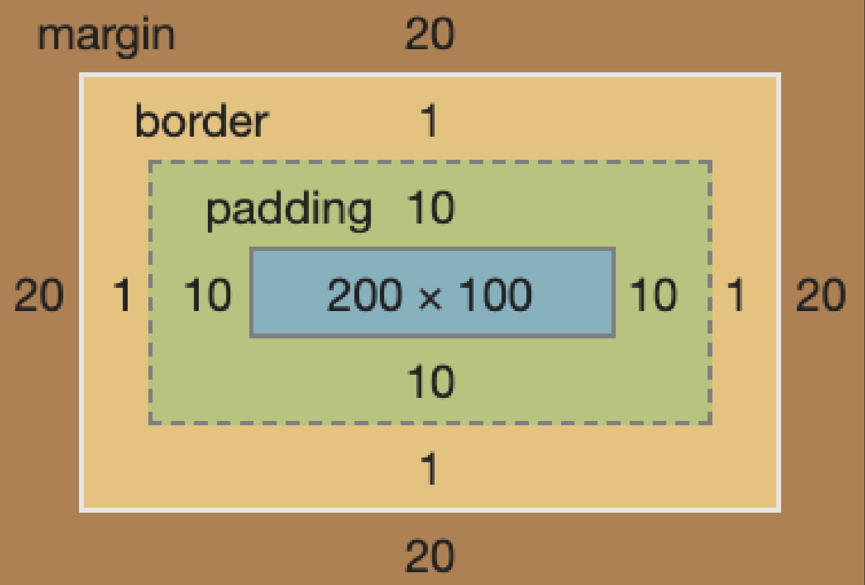
CSS Box Model
Margin
Outside the border, for spacing between elements
Border
Edge of the box
Padding
Inside the border, for spacing between the content and box edge

Slide 13
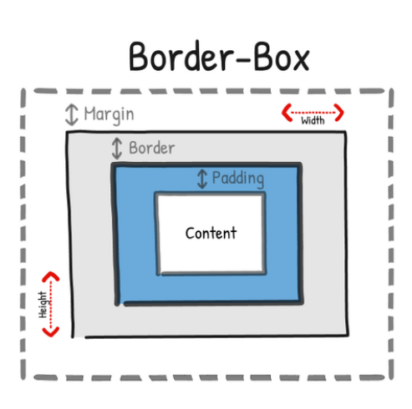
CSS Box sizing
By default:
actual width of an element = width + padding + border
actual height of an element = height + padding + border
box-sizing: border-box;
Includes border and padding in the element's total width and height

Slide 14
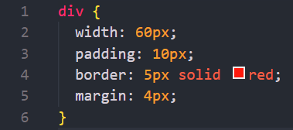
What is width of this div?

Slide 15
What is the width of this div?
ⓘ
Click Present with Slido or install our Chrome extension to activate this poll while presenting.
Notes:
📣 This is Slido interaction slide, please don't delete it. ✅ Click on 'Present with Slido' and the poll will launch automatically when you get to this slide.

Slide 16
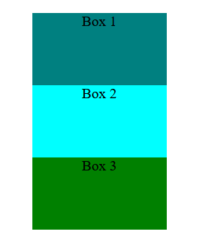
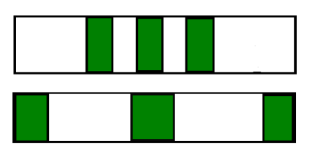

CSS ‘Display’ Property
Block
None
Inline
Flex
Every element is rendered in a box; ‘display’ specifies the type of box
Starts on a new line, fills width
Completely removes element
Stays on same line, width of content
Positions child/inner elements based on available space

Slide 17
Flexbox
Flexbox is a layout method for arranging items in rows or columns.
Justify-content is used to manage the space between and around content items along the main-axis of a flex container.
Align-items is used to control the alignment of items on the Cross Axis
Align-content is used to manage the space between and around content items along cross-axis of a flex container, only when there is more than one line!

Slide 18
Flexbox
Flex-direction: row
Flex-direction: column
Main axis
1
1
2
3
2
Cross axis
Main axis
3
Cross axis

Slide 19

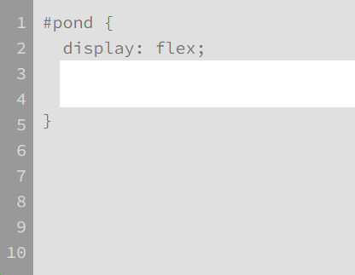
Which CSS flexbox properties are missing in lines 3 and 4?

Slide 20
Which CSS flexbox properties are missing in lines 3 and 4?
ⓘ
Click Present with Slido or install our Chrome extension to activate this poll while presenting.
Notes:
📣 This is Slido interaction slide, please don't delete it. ✅ Click on 'Present with Slido' and the poll will launch automatically when you get to this slide.

Slide 21
HTML/CSS Demo
Simple Box and CSS Properties
Use HTML/CSS to show some properties and how to improve css code

Slide 22
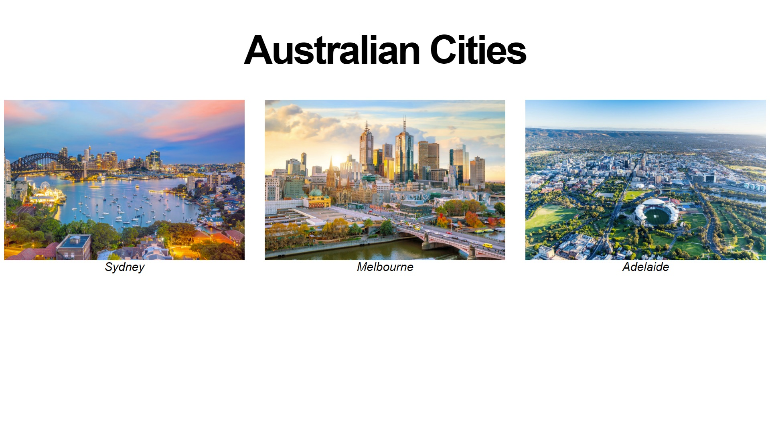
Tutorial Exercise
css-replicate-cities-layout
Use CSS to replicate a layout of information about cities

Slide 23
Wrap Up
This Week
Icebreaker: Discussing good/bad websites
Recap: CSS Specificity/Box Sizing, Box Model/’Display’ Property, Flexbox
Tutorial Exercise: css-replicate-cities-layout
For Next Week
Start Assignment 1!
Experiment with HTML/CSS pages

Slide 24


Edison’s Tutorial Resources
Slides
Feedback
I love feedback!
https://drive.google.com/drive/folders/1P3O9wqIxYxjbZ02UvUYIdQEYjtLlOpmm?usp=sharing
https://forms.gle/QH29rsr7xt7hp6rc8

